Slide 1
Trafficking and the Sex Industry Studies Findings
COYOTE RI Executive Director Bella Robinson
&
Brown University Professor Elena Shih

Slide 2
Background Information
In the late 1970s, COYOTE founder Margo St. James successfully filed a lawsuit against Rhode Island that decriminalized sex work. However, in 2009, following heightened pressure from anti-trafficking advocacy groups, the state re-criminalized prostitution in the name of protecting victims of sexual exploitation.

Slide 3
STUDY #1
Rhode Island-focused
63 respondents
40 questions
2015-2017

Slide 4
Study #1
Special thanks to Tara Burns whose 2015 study “People in Alaska’s Sex Trade: Their Lived Experiences And Policy Recommendations” provided the inspiration and basis for this study.
Trafficking and the Sex Industry in Rhode Island (2015-2017)
The study had 63 respondents answer 40 questions focusing primarily on the concrete impact of the 2009 re-criminalization of Rhode Island sex workers. It explores the experiences of violence and exploitation in seeking services such as medical help or reporting crimes, as well as the effects that contemporary anti-trafficking efforts have had on the policing of sex workers, especially those in racial minority or immigrant communities.

Slide 5
General Conclusions
Overwhelming attention towards human trafficking has resulted in carceral and prosecutorial as opposed to social welfare interventions
Proxy indicators of human trafficking encourage the surveillance and policing and already marginalized groups (Asian massage parlor workers, immigrant communities)
There have been increased instances of civilian vigilantism alongside police surveillance and violence

Slide 6
Data and Finding Highlights

Slide 7
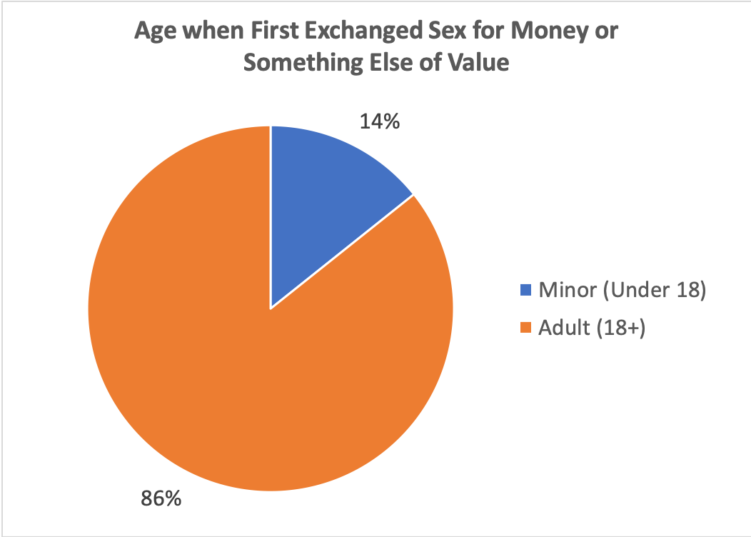
Age of Entry
86% of respondents “entered” the sex industry (in some capacity) as adults, contrasting the arguments that we hear from the anti-trafficking narrative that a large percentage of those selling sex are under age 18.

Slide 8
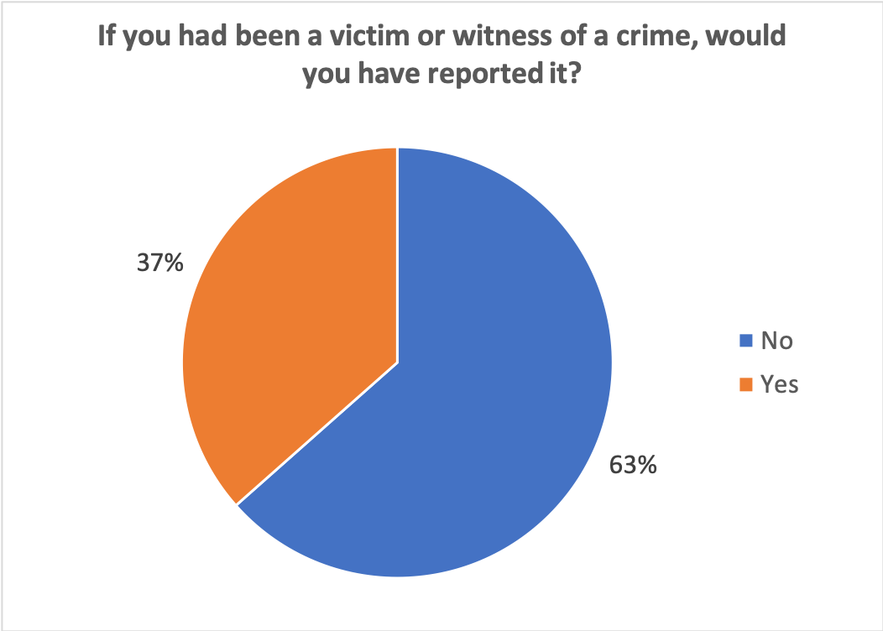
Reporting
63% of respondents said that they would not report if they had been a victim or a witness of a crime. In answering, respondents expressed fear of being arrested themselves, that the police wouldn’t do anything, and that too much attention would be drawn to themselves or their co-workers.

Slide 9
Sex Trafficking Laws
“Funny though, how often do you hear the phrase ‘Dishwasher trafficking?’ In actuality I define [sex trafficking] as a useless term used to misrepresent the sex industry and to remove agency from migrants and youth.”
Respondents tended to be unaware of Rhode Island sex trafficking law with 60% reporting having no knowledge of it. When asked if they considered themselves victims of sex trafficking according to their own definition, however, 41 out of 41 respondents answered no in some form.
The definition of sex trafficking given by sex workers and by Rhode Island law differ in many ways. Respondents did agree that sex trafficking means to force or coerce someone into sex work. But, unlike RI law, sex workers’ definitions pointed out the nuance between sex work and sex trafficking. Several respondents brought up the need to talk about the differences between terms to “clear the debating field for useful and separate discussions of both.” This data speaks to the difficulty of using the rhetoric of “sex trafficking” as a way to police sex workers, as it is hard to create simple black and white categories. As one respondent put it, it is “such a complicated question because many people that are not trafficked fall under the umbrella because they fit some part of the description.”

Slide 10
Respondent Quotations 1
Question: What did the police do that was not helpful?
“Arrest me for marijuana possession when they were called for a suicide okay check; handcuffed me for 4 hours when I was robbed at gunpoint; disparaged my occupation on the stand when I was a victim of a hit and run.”
“rape and rob me”
“They took everything. I had no money for bus fare or to get home. I was left on on the street...I never felt more helpless in my life.”
“They told me that if I wanted to report a client who raped me that they would arrest me for prostitution.”
“The[y] kicked in my door to my home without a warrant, waving guns around screaming ‘we know what[‘]s going on here’ because I had a[n] online escort ad. This was the most traumatic event of my life, and has left me with PTSD.”

Slide 11
Respondent Quotations 2
Question: What would you tell Rhode Island police officers, about how to best serve and protect people involved in the sex industry?
“Leave us the fuck alone.”
“Prostitution will NEVER go away, by arresting those who do this of free will only makes it more dangerous for us ladies. Go after the real traffickers of children!”
“Many sex workers are of legal age and choose this job because they really do want to do it. Don't ‘save’ all when most don't want or need [to be] ‘saved.’”
“Treat transgender people with respect and dignity.”
“Remember sex workers are people.”
“Protect sex workers by making a less hostile environment for them to report to.”
“Help and [support] the elimination of the law against prostitution.”

Slide 12
Respondent Quotations 3
Question: Have I forgotten to ask you anything about the police?
“The cop told me that if I told anyone that he raped me, other cops would come looking for me, and they would rape + kill me. He took my ID and copied down my name and address and he knows where I live.”
“I was raped by a cop that came to [visit] me and didn't want to pay. He told me that if I said anything that I would be raided and gang raped by other cops. I know 2 other Providence escorts that have to pay off a cop every week + give him a freebie or he will make sure they go to jail.”
“I have had some good [clients] that worked in law enforcement, but there are just as many bad cops running around shaking down escorts and expecting us to give them freebies. I had never been exploited by a police officer until after I tried to report a violent man that raped me.”

Slide 13
Respondent Quotations 4
Question: What laws do you think would protect people in the sex industry?
A large number of respondents answered with decriminalization. For instance:
  “Decriminalization of the buying and selling of sex between consenting adults.”
  “Decriminalization, to start.”
  “Make it legal, pay taxes like every other job out there.”
  “I think decriminalizing consensual adult sex work and creating labor laws would solve most problems in the sex industry and it would reduce violence + trafficking.”
Also:
  “Hate crimes against prostitution”
  “Being able to report crimes and be taken seriously.”

Slide 14
STUDY #2
National scope
1,515 respondents
145 questions
2017

Slide 15
Study #2
Research conducted with Desiree Alliance and SWOP Behind Bars.
Trafficking and the Sex Industry in the United States (2017)
In 2017, COYOTE RI conducted the first national sex worker-led survey of trafficking and the sex industry in the United States in collaboration with the Sex Workers Outreach Project Behind Bars. This study grew out of the Rhode Island study and surveyed 1,515 sex workers nationwide to better understand the realities of consensual sex work and coerced sex trafficking in the US. As community-based research, this project was innovative and important in that it was conceived of and for sex workers, providing an understanding and lack of bias against people working in the sex industry.

Slide 16
General Conclusions
Respondents discussed their experiences engaging in consensual sex work and experiences with sex trafficking in relation to their family and relationships, health, employment, and involvement in the criminal justice system. This research finds that anti-trafficking laws have expanded policing and surveillance of sex workers. Additionally, this data provides a view of how sex workers who have never considered themselves victims of trafficking have been impacted by the rise in policy and concern surrounding trafficking and the effects of conflating the two.

Slide 17
Data and Finding Highlights

Slide 18
Labor Stats
22 years old: average age of entry into sex industry
7 years: average number of years in the sex industry
90% of respondents have worked in other industries (in addition to the sex industry).

Slide 19
Crime & Injustice Stats
44% reported having faced bias, hostility, or refusal of services because of being a sex worker.
51% reported being a victim of a crime while working. Rape and sexual assault were frequently reported.
71% responded that if they were a victim or witness of a crime, they would not report it (because of fear of arrest, belief that police wouldn’t do anything, fear of drawing attention to oneself, etc.)

Slide 20
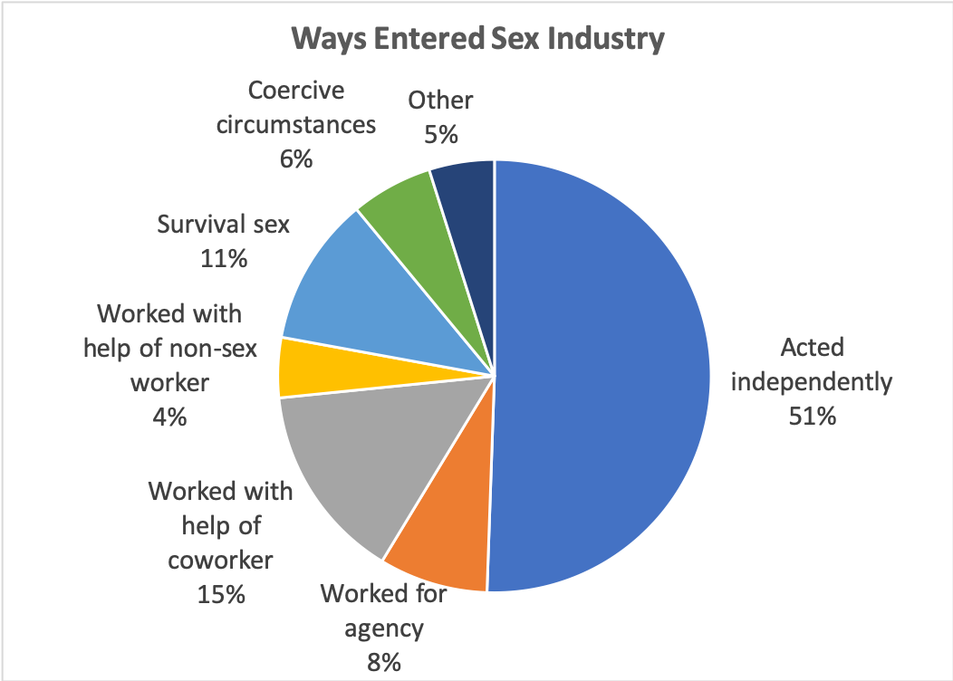
Entering the Sex Industry
51% of respondents entered the sex industry working independently. This counters trafficking narratives we hear that the vast majority of people in the sex industry are forced into the industry.

Slide 21
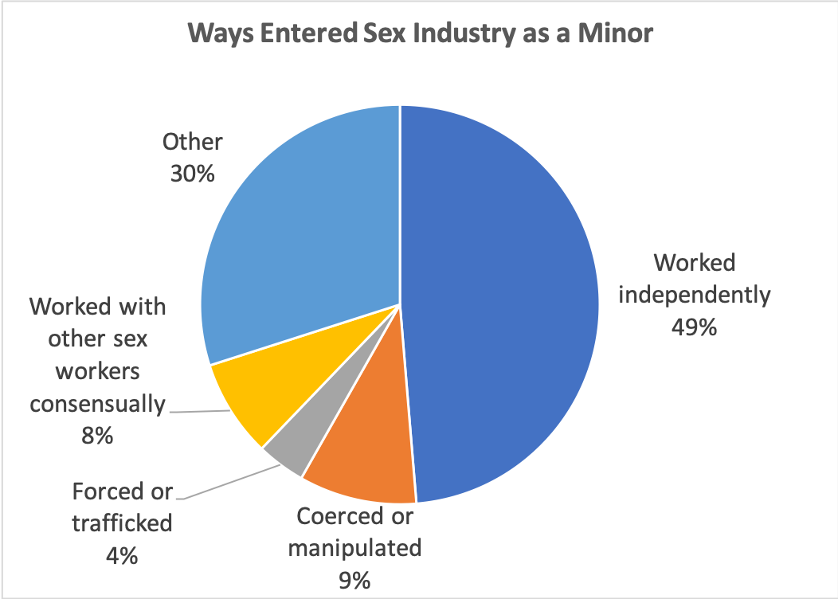
Entering the Sex Industry as a Minor
For those who did enter the sex industry as minors, the vast majority also entered the industry working independently (49%). Although we of course do not recommend minors selling sex, the narrative that large numbers of minors are being forced, coerced, manipulated, or trafficked into the sex industry is simply not supported by our research.

Slide 22
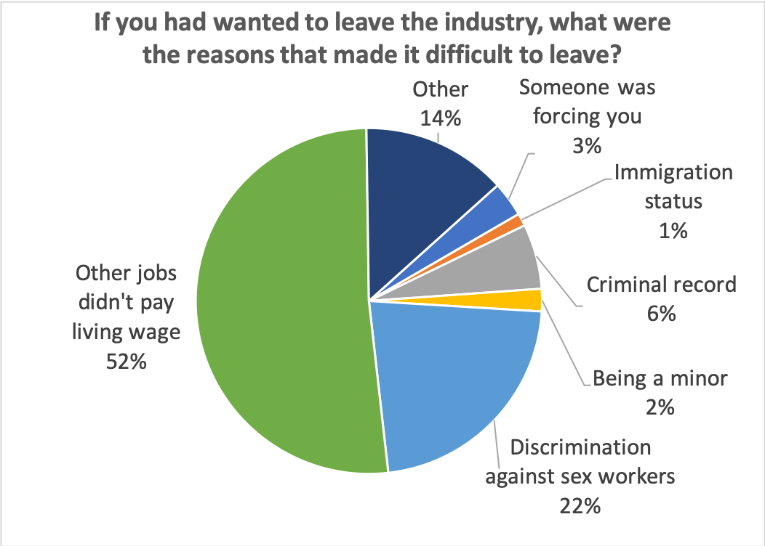
Leaving the Sex Industry
For those who had wanted to leave the sex industry, the majority of respondents said that the fact that other jobs don’t pay a living wage made it difficult to leave (52%). 22% said discrimination against sex workers made it difficult to leave. Only a small percentage of respondents said it was difficult to leave because they were being forced to sell sex, which challenges the narrative we typically hear.

Slide 23
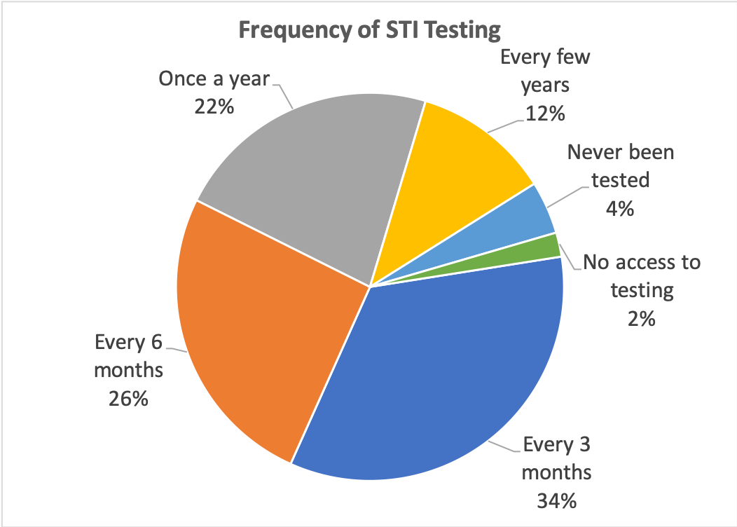
Health: STI Testing
The vast majority of sex workers are getting frequently tested for STI testing, countering a whole slew of sex worker-phobic assertions. Furthermore, for those who don’t get tested as regularly, many reported that they do not need to get tested as regularly because they aren’t having direct contact with clients (they are cam workers, there’s no skin-to-skin contact, etc.).
Unfortunately, 35% of respondents did report a lack of reliable access to sex worker-friendly health services. We received many reports of prejudiced attitudes directed at sex workers.

Slide 24
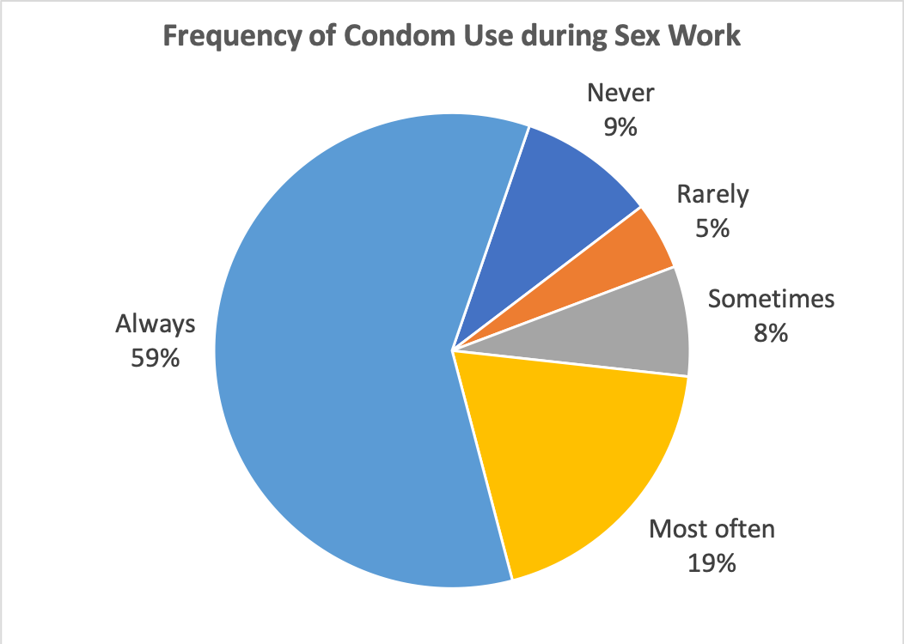
Health: Condom Use
The vast majority of respondents are using condoms always or frequently during sex work. This data also counters many sex worker-phobic beliefs. Again, many respondents reported not needing to use condoms during sex work because of a lack of direct contact with clients.

Slide 25
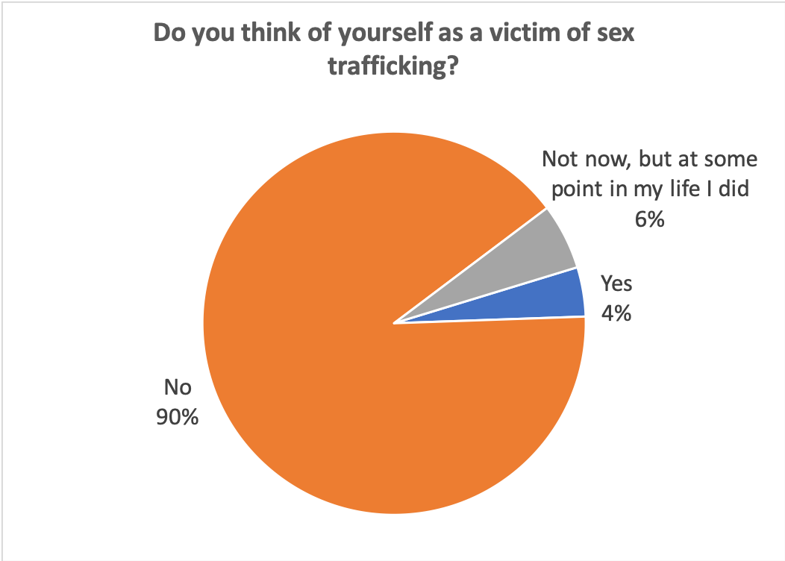
Sex Trafficking
Respondents discussed many reasons they chose to do sex work, many of which complicate the dynamic of whether or not they were coerced. Respondents discuss feeling pressure due to finances or interpersonal relationships, but widely do not consider themselves trafficking victims. 90% of respondents do not and have never regarded themselves as victims of sex trafficking. Moreover, many cited decriminalization of sex work as a way to prevent sex trafficking and protect sex workers.

Slide 26
Respondent Quotations 1
Question: What would you tell doctors and other health care providers about how to provide good medical care to people involved in the sex industry?
“If you think we're dirty, we can tell.”
“Treat them like a human being. Don't assume their health conditions, mental or physical are a result of the industry.”
“I would say that judgment perpetuates stigma and prevents people from seeking care.”
“There is already a lot of shame put on us and I don't want to talk to someone I am supposed to trust only to find they would also shame me.”
“Sex work doesn't ‘cause’ mental illness or ill health -- past and current trauma, oppression, and lack of coverage and safety nets for workers does.”

Slide 27
Respondent Quotations 2
Question: What would you tell shelters about how they can best help people who are involved in the sex industry?
“To allow people to remain in shelter when they're working. Many domestic violence shelters kick women out for working.”
“Don't turn sex workers away. And don't report minors engaging in survival sex work or tell their parents where they are. So many LGBT kids run away from abusive homes and engage in survival sex work to get by. Let them decide which of those things they would rather do.”
“Don't try to be saviors, just ask the person what it is that they need.”

Slide 28
Respondent Quotations 3
Question: What did the police do that was not helpful?
“Assault me during the arrest and then tell me that if we'd met under different circumstances he'd ask me out when we were at the station.”
“Forced me to perform oral.”
“Ignore my pleas for help, act like I deserved assault, assaulted me themselves, encouraged other prisoners to harass/assault me, look the other way.”
“First time, they laughed in my face and told me I was a slut for what I was wearing and what I was drinking.”
“They had sexual contact with me before arresting me. They let me out at 3am in a city where I did not live, with no money, phone, or way to get anywhere.”

Slide 29
Respondent Quotations 4
Question: What would you tell the criminal justice system how to better represent sex workers?
“Decriminalize. Stop arresting sex workers.”
“Quit treating us all as victims. I enjoy my job. I'm not being trafficked.”
“Realize that we need rights, not rescue.”
“We are human beings. Don't treat us as less. What we do is not bringing harm to others. What we do should be completely legal. We need more rights. We need people to care about us.”
“Police stings ruin lives. Consenting adults are no threat to society and publicly shaming sex workers and clients is merciless.”
“Stop arresting street workers. Stop targeting trans women. Treat sex workers like people and not victims. Stop raping sex workers.”

Slide 30
CONCLUSION? IDEAS?

